Slide 2
Monolith Applications
Distributed Systems
SOA
CQRS
Event Sourcing
DDD
Messaging Queue

Slide 3
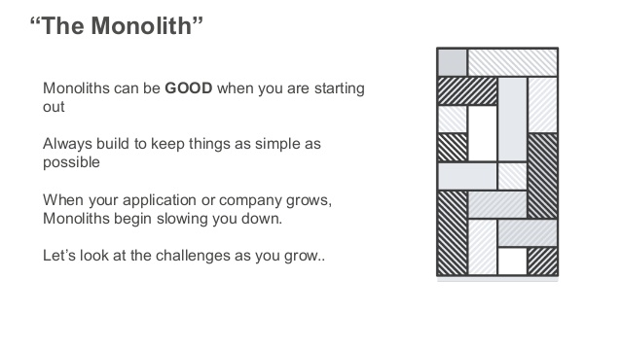

Slide 4
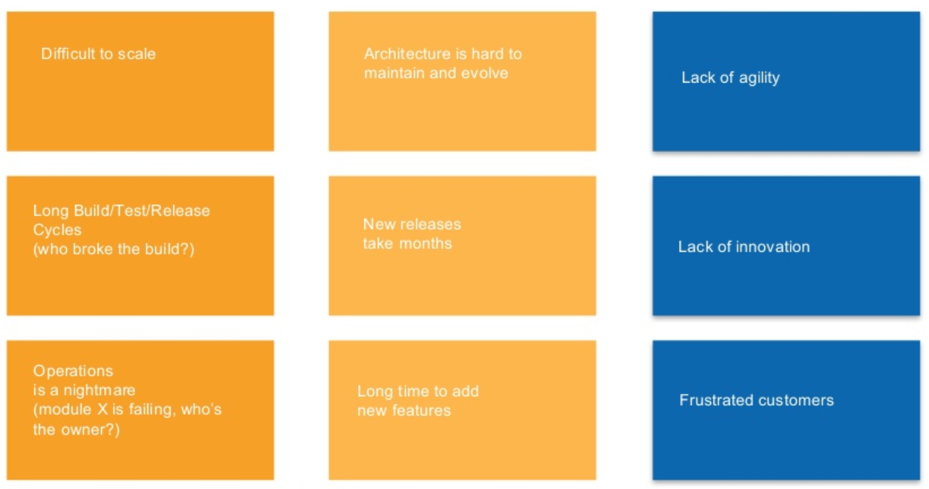

Slide 5
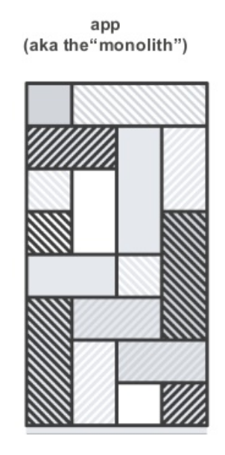
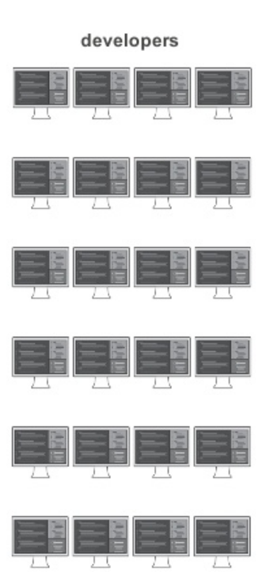
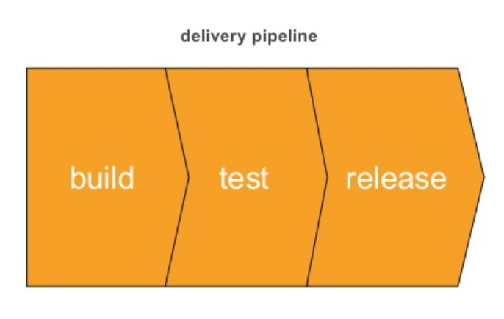
Monolith Development Life cycle

Slide 6
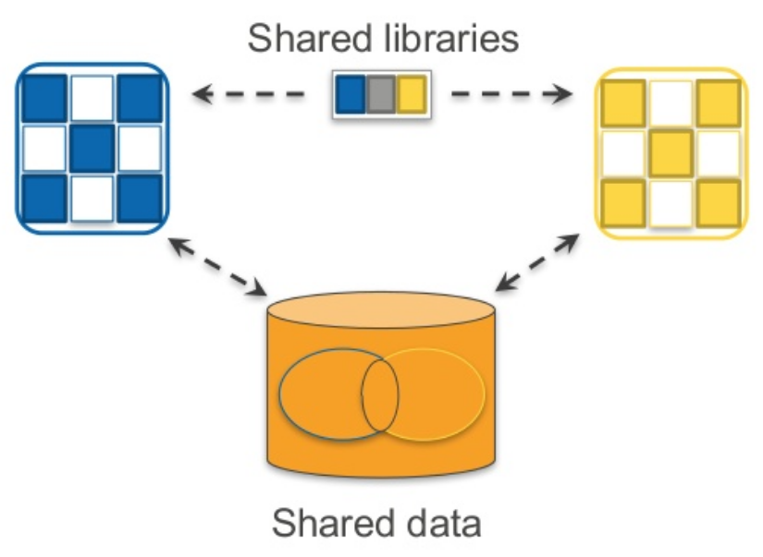
Software Coupling

Slide 7
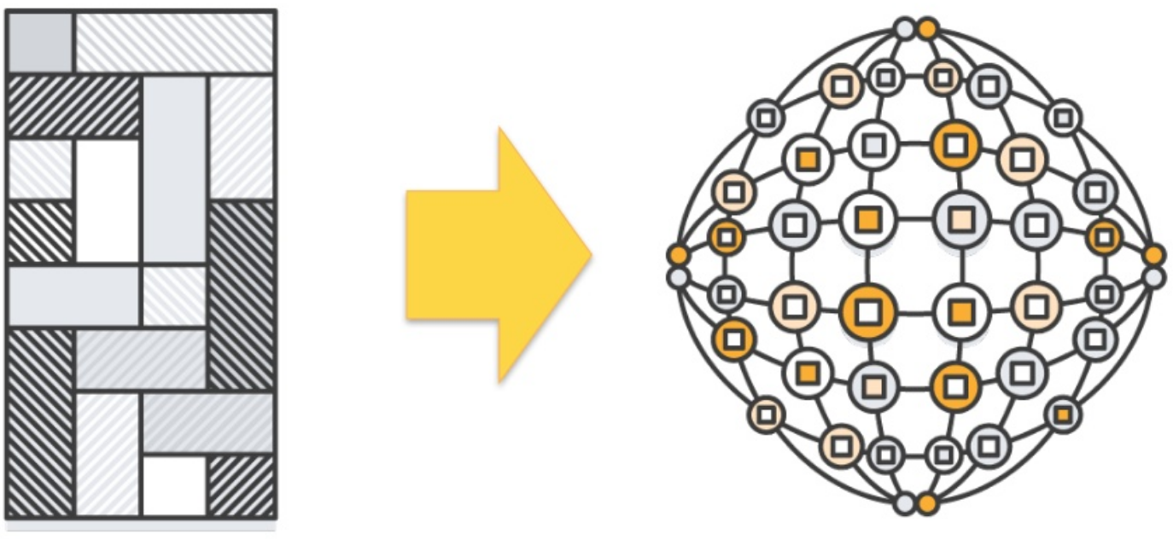
Software Coupling

Slide 8
Software Architecture Patterns
Monolith Applications
Distributed Systems
SOA
CQRS
Event Sourcing
DDD
Messaging Queue
Microservices

Slide 9
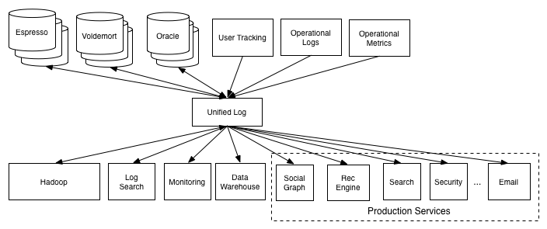
Distributed Systems
In distributed architecture, components are presented on different platforms and several components can cooperate with one another over a communication network in order to achieve a specific objective or goal.

Slide 10
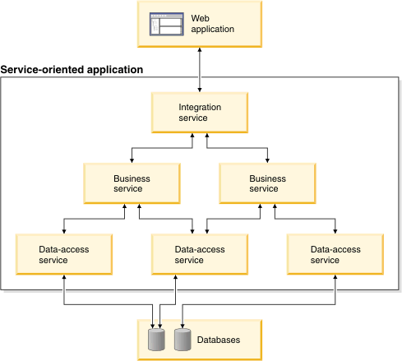
Service-Oriented Architecture (SOA)
A service-oriented architecture is essentially a collection of services. These services communicate with each other. The communication can involve either simple data passing or it could involve two or more services coordinating some activity. Some means of connecting services to each other is needed.

Slide 11
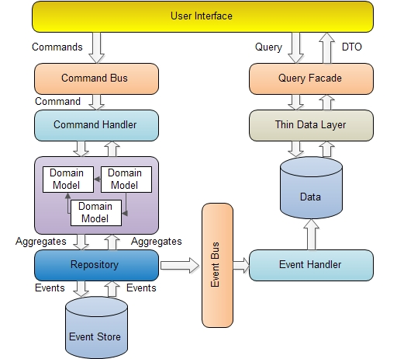
Design Patterns and Components
CQRS Pattern: Command and Query Responsibility Separation

Slide 12
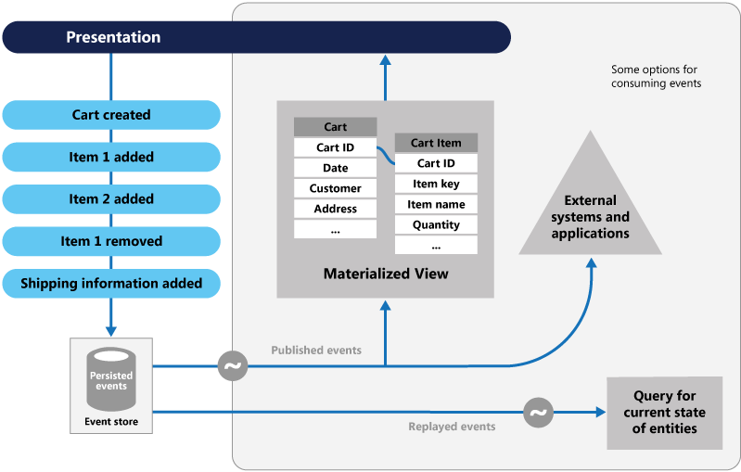
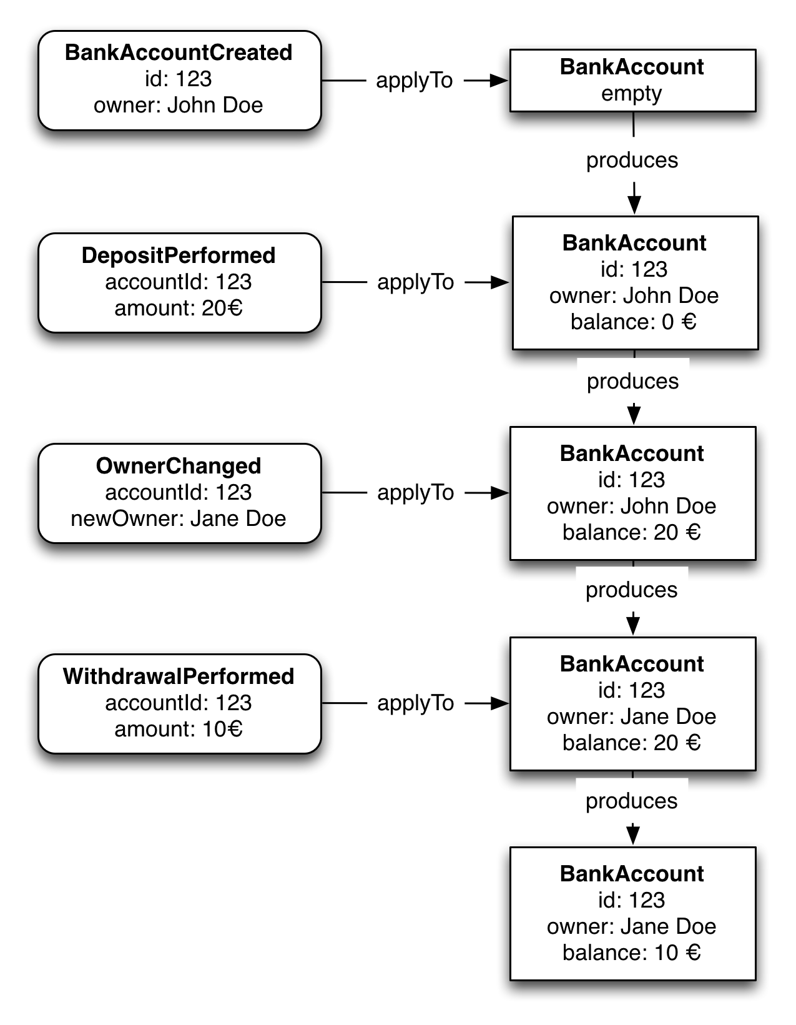
Event Sourcing Pattern
With Event Sourcing Pattern, the idea is we don’t save object’s final state in our data store, instead, we use this “Append Only” approach where we just record the events as a sequence in a stream of events, and every time we want to know what is the current state of an object, we start from the beginning of the event stream, execute them all, and find out the final state.

Slide 13
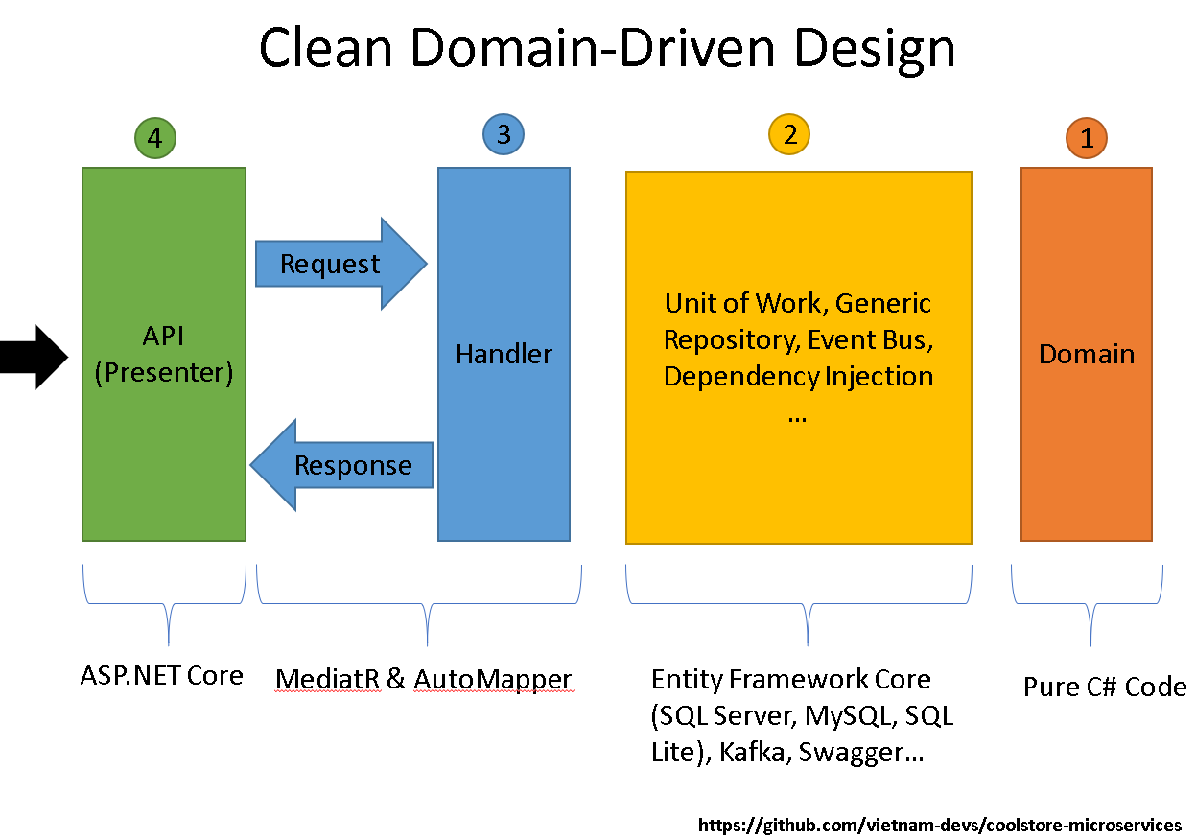
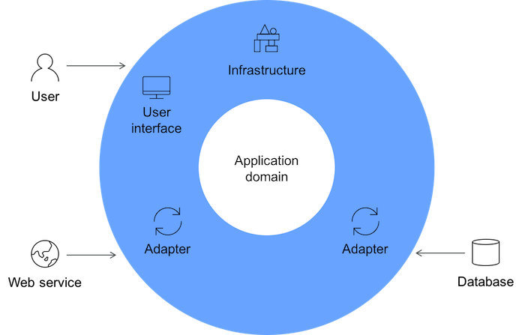
Domain-driven design (DDD)
Domain-driven design (DDD) is an approach to software development for complex needs by connecting the implementation to an evolving model.

Slide 14
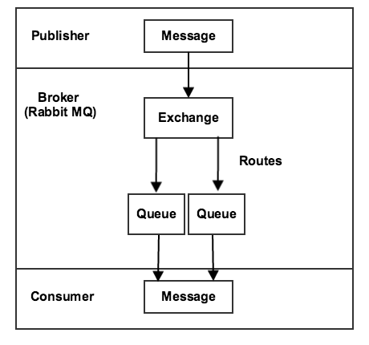
Message Queue
A message queue is a form of asynchronous service-to-service communication used in serverless and microservices architectures. Messages are stored on the queue until they are processed and deleted. Each message is processed only once, by a single consumer.

Slide 15
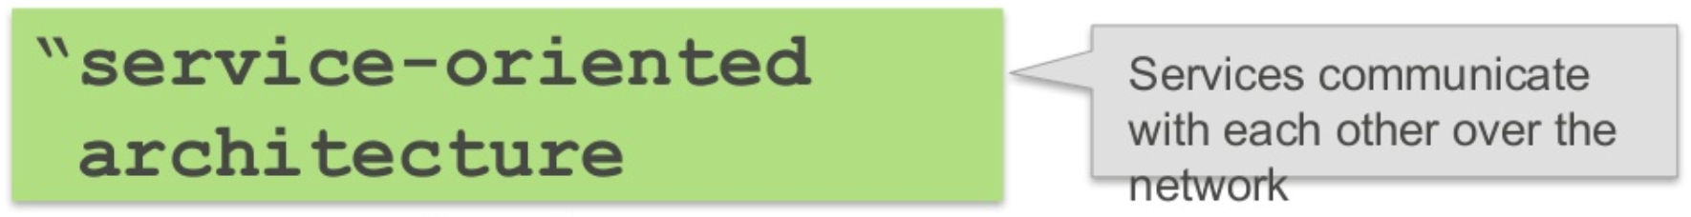
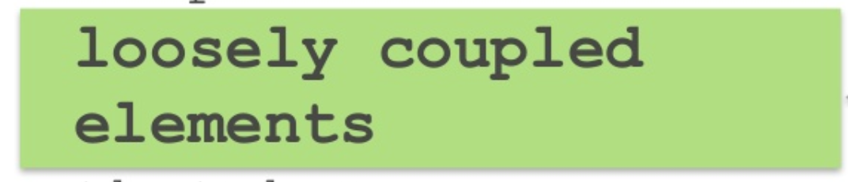
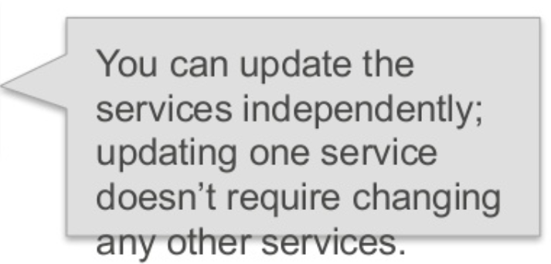
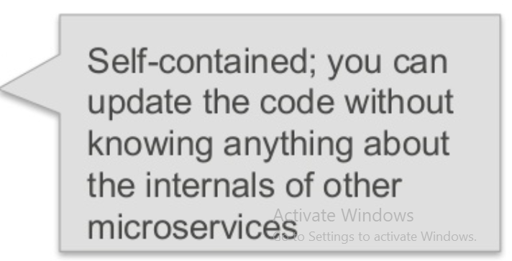
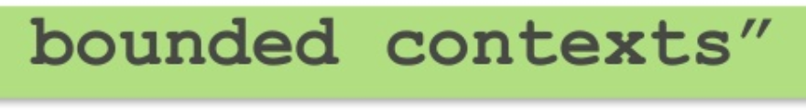
What is Microservices?

Slide 16
What is Microservices?
Small, independent applications
loosely coupled,
Communicating with each other in an asynchronous manner,
Can fail independently,
If one or some fails, the system as a whole still works, though the functionality might be downgraded when there are failures.

Slide 17
Why you should build Microservices?
It is cool, and it is this shiny new thing!
I mean, Netflix uses Microservices, so should we!
Easier to understand Small services
Services are independently deployable
Easier to adopt to newer technology (retire vs rewrite)
Easier to scale small services
No single point of failure
Freedom of technology stack choices
It is quicker to evolve and release business features
Gives you a path to move away from your legacy code

Slide 18
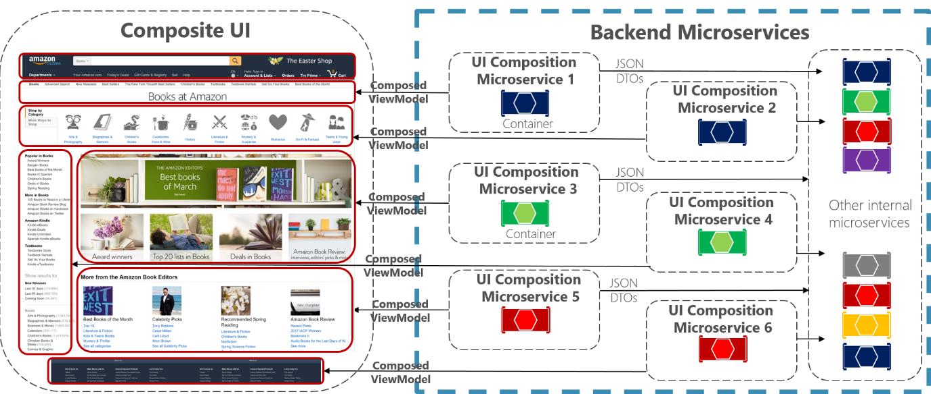
Microservices Examples

Slide 19
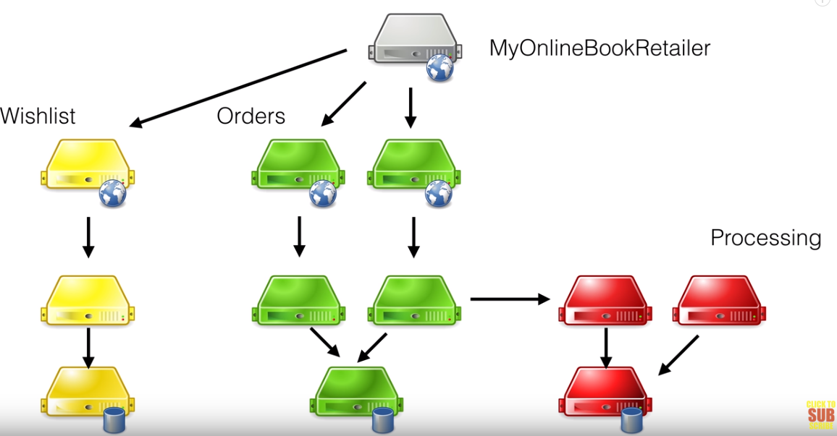

Slide 20
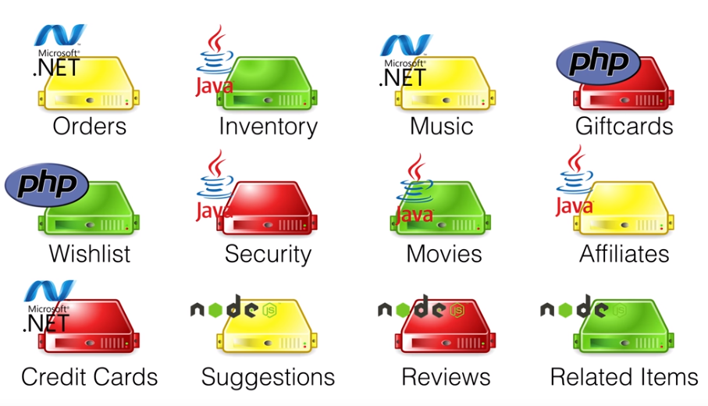

Slide 21
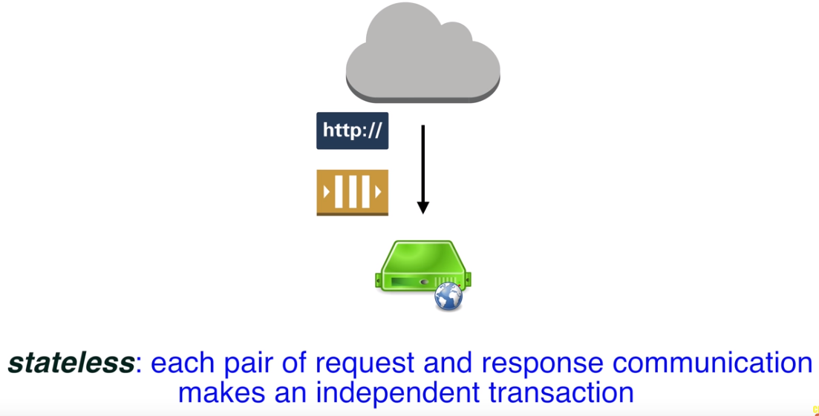

Slide 22
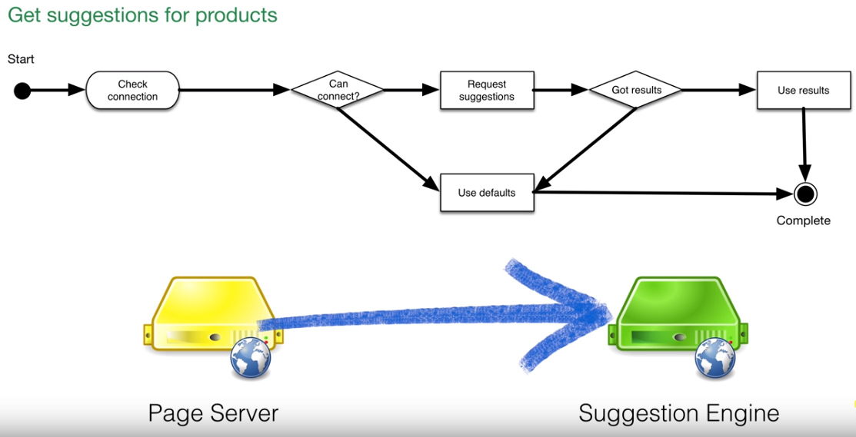

Slide 23
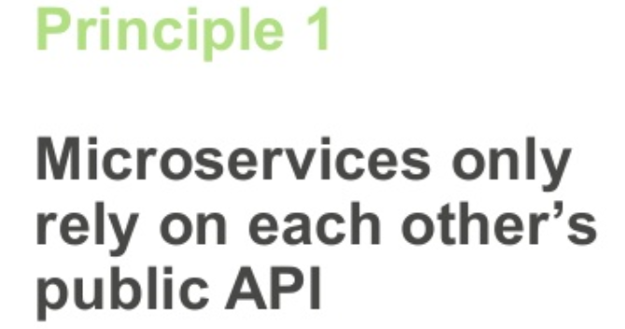
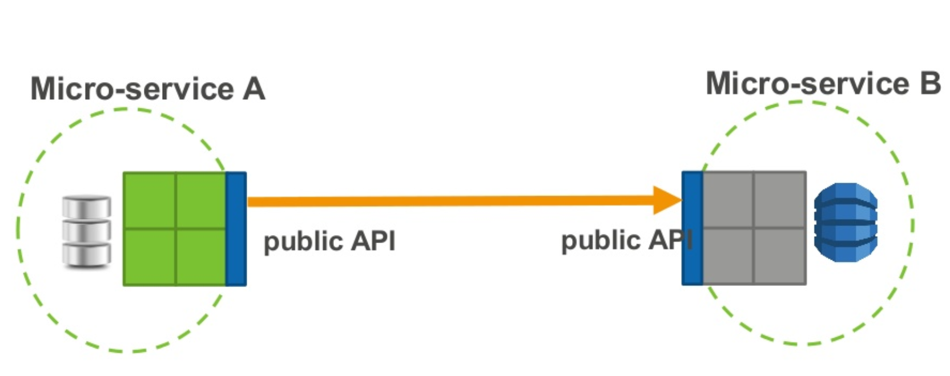
Microservices Principles

Slide 24
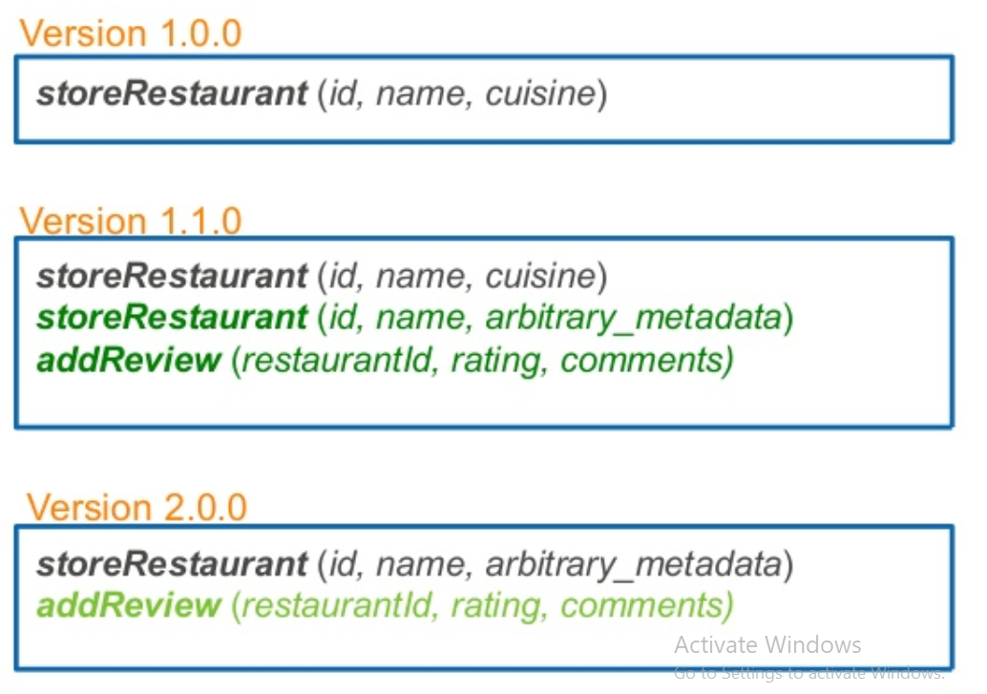
Microservices Principles

Slide 25
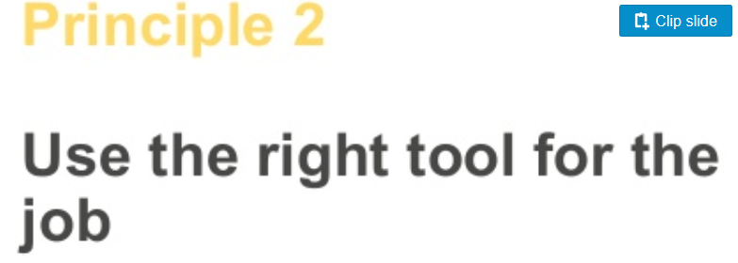
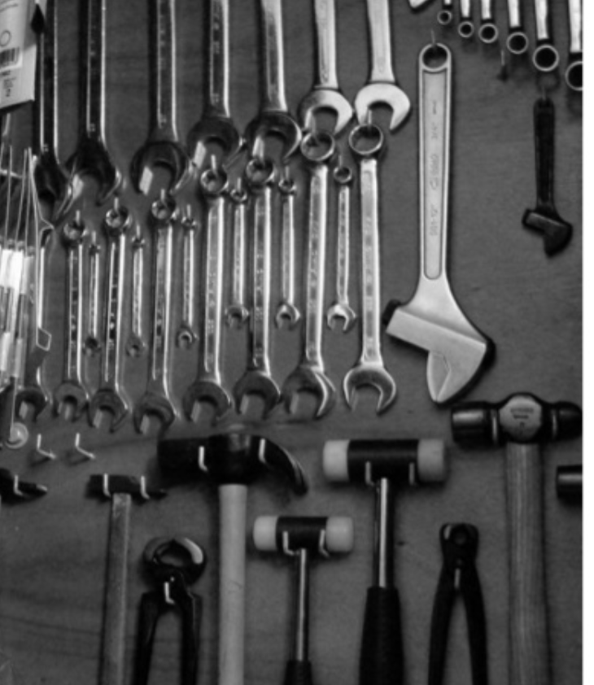
Microservices Principles

Slide 26

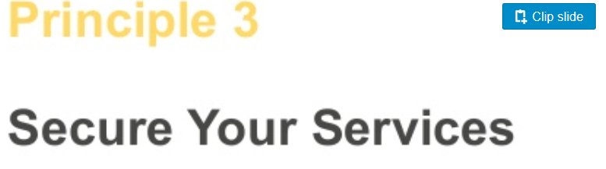
Microservices Principles

Slide 27
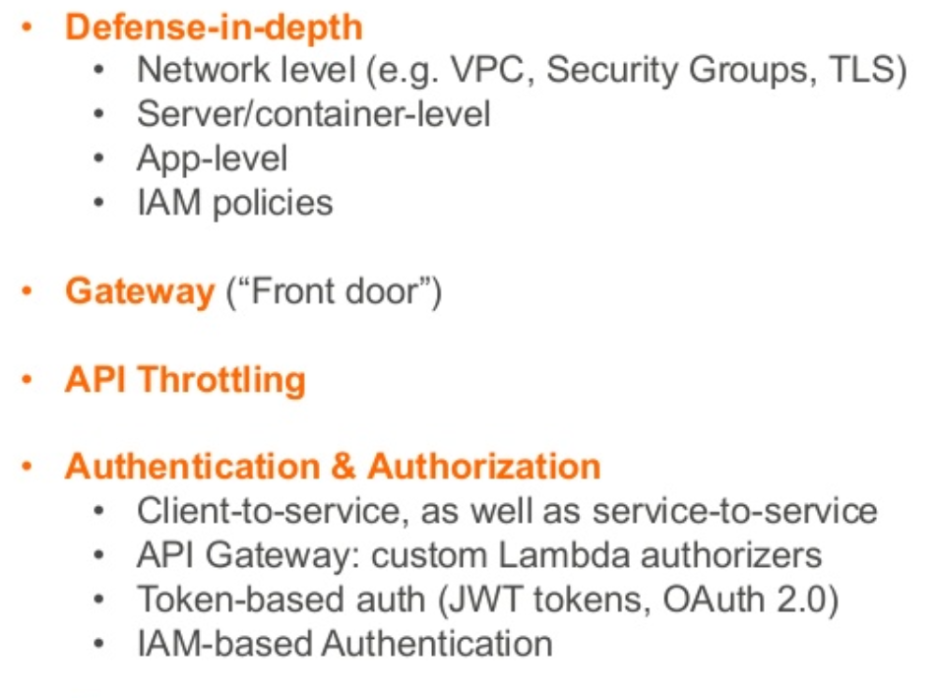
Microservices Principles

Slide 28
